Slide 1
AMC Figshare trial: publishing data sets
Agenda
Benefits open data | - Figshare
2 examples
AMC Figshare specific benefits
How to obtain an AMC Figshare account

Slide 2
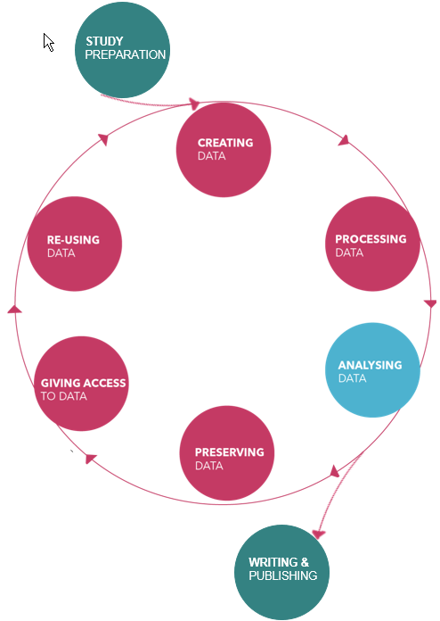

Slide 3
AMC Figshare trial
Open data benefits:
Other researchers trust your results more
Is associated with more attention and higher citation rates
It promotes building of new collaborations
Figshare benefits for publishing data:
Enhance retrieval of your research
Control how content is published and shared internally or publically
Decide what you want to share with whom primary data | aggregated data | metadata | supplementary material

Slide 4
AMC Figshare trial
Example 1 (integral material of a publication):
HIV-infected men who have sex with men who identify themselves as belonging to subcultures are at increased risk for hepatitis C infection.
Matser A, Vanhommerig J, Schim van der Loeff MF, Geskus RB, de Vries HJ, Prins JM, Prins M, Bruisten SM.
PLoS One. 2013;8(3):e57740. doi: 10.1371/journal.pone.0057740. Epub 2013 Mar 4
PubMed: https://www.ncbi.nlm.nih.gov/pubmed/23469226 (reference)
PLoS Journal: http://journals.plos.org/plosone/article?id=10.1371/journal.pone.0057740 (full text article)
PLoS Figshare: https://doi.org/10.1371/journal.pone.0057740.t001 (aggregated info supporting tables)
Example 2 (additional supplementary material to a publication):
Pregnancy Outcomes in Patients with Glomerular Disease Attending a Single Academic Center in North Carolina.
O'Shaughnessy MM, Jobson MA, Sims K, Liberty AL, Nachman PH, Pendergraft WF.
Am J Nephrol. 2017;45(5):442-451. doi: 10.1159/000471894. Epub 2017 Apr 27. PubMed: https://www.ncbi.nlm.nih.gov/pubmed/28445873 (reference)
Karger Journal: https://www.karger.com/Article/FullText/471894 (full text article)
Karger Figshare: https://doi.org/10.6084/m9.figshare.4960199.v1 (additional PPT slides)

Slide 5
AMC Figshare trial
AMC Figshare specific publishing benefits:
Storage space of 25 GB (upscalable!) (standard 5 GB)
Secure file sharing / collaboration
Curation workflow Check on: researcher identity | privacy protection research subjects
‘Seal of approval’ AMC affilitation in URL
ISO certified servers in Switzerland
Create or reserve a DOI (AMC reference incorporated)
Support for all your Figshare questions / issues

Slide 6
AMC Figshare trial
How to obtain an AMC Figshare account:
Requirements: Data must be generated in the AMC by an AMC researcher under final responsibility of an AMC Principle Investigator (PI)
Account request: Joost Daams j.g.daams@amc.uva.nl 020-5668894
More information: - http://intranet.amc.nl/web/personeel/links-voor-de-werkplek/amc-literatuur/amc-figshare.htm - https://uvaauas.figshare.com/amc

